Slide 1

Basic Details of the Team and Problem Statement
Ministry/Organization Name/Student Innovation: Government of Gujarat
PS Code: SIH1365
Problem Statement Title: Online Blockchain-based certificate generation and validation system for government organizations.
Team Name: Block wing
Team Leader Name: Steeve P P
Institute Code (AISHE):U-0460
Institute Name: Karunya Institute of Technology and Sciences
Theme Name: Blockchain and Cybersecurity

Slide 2
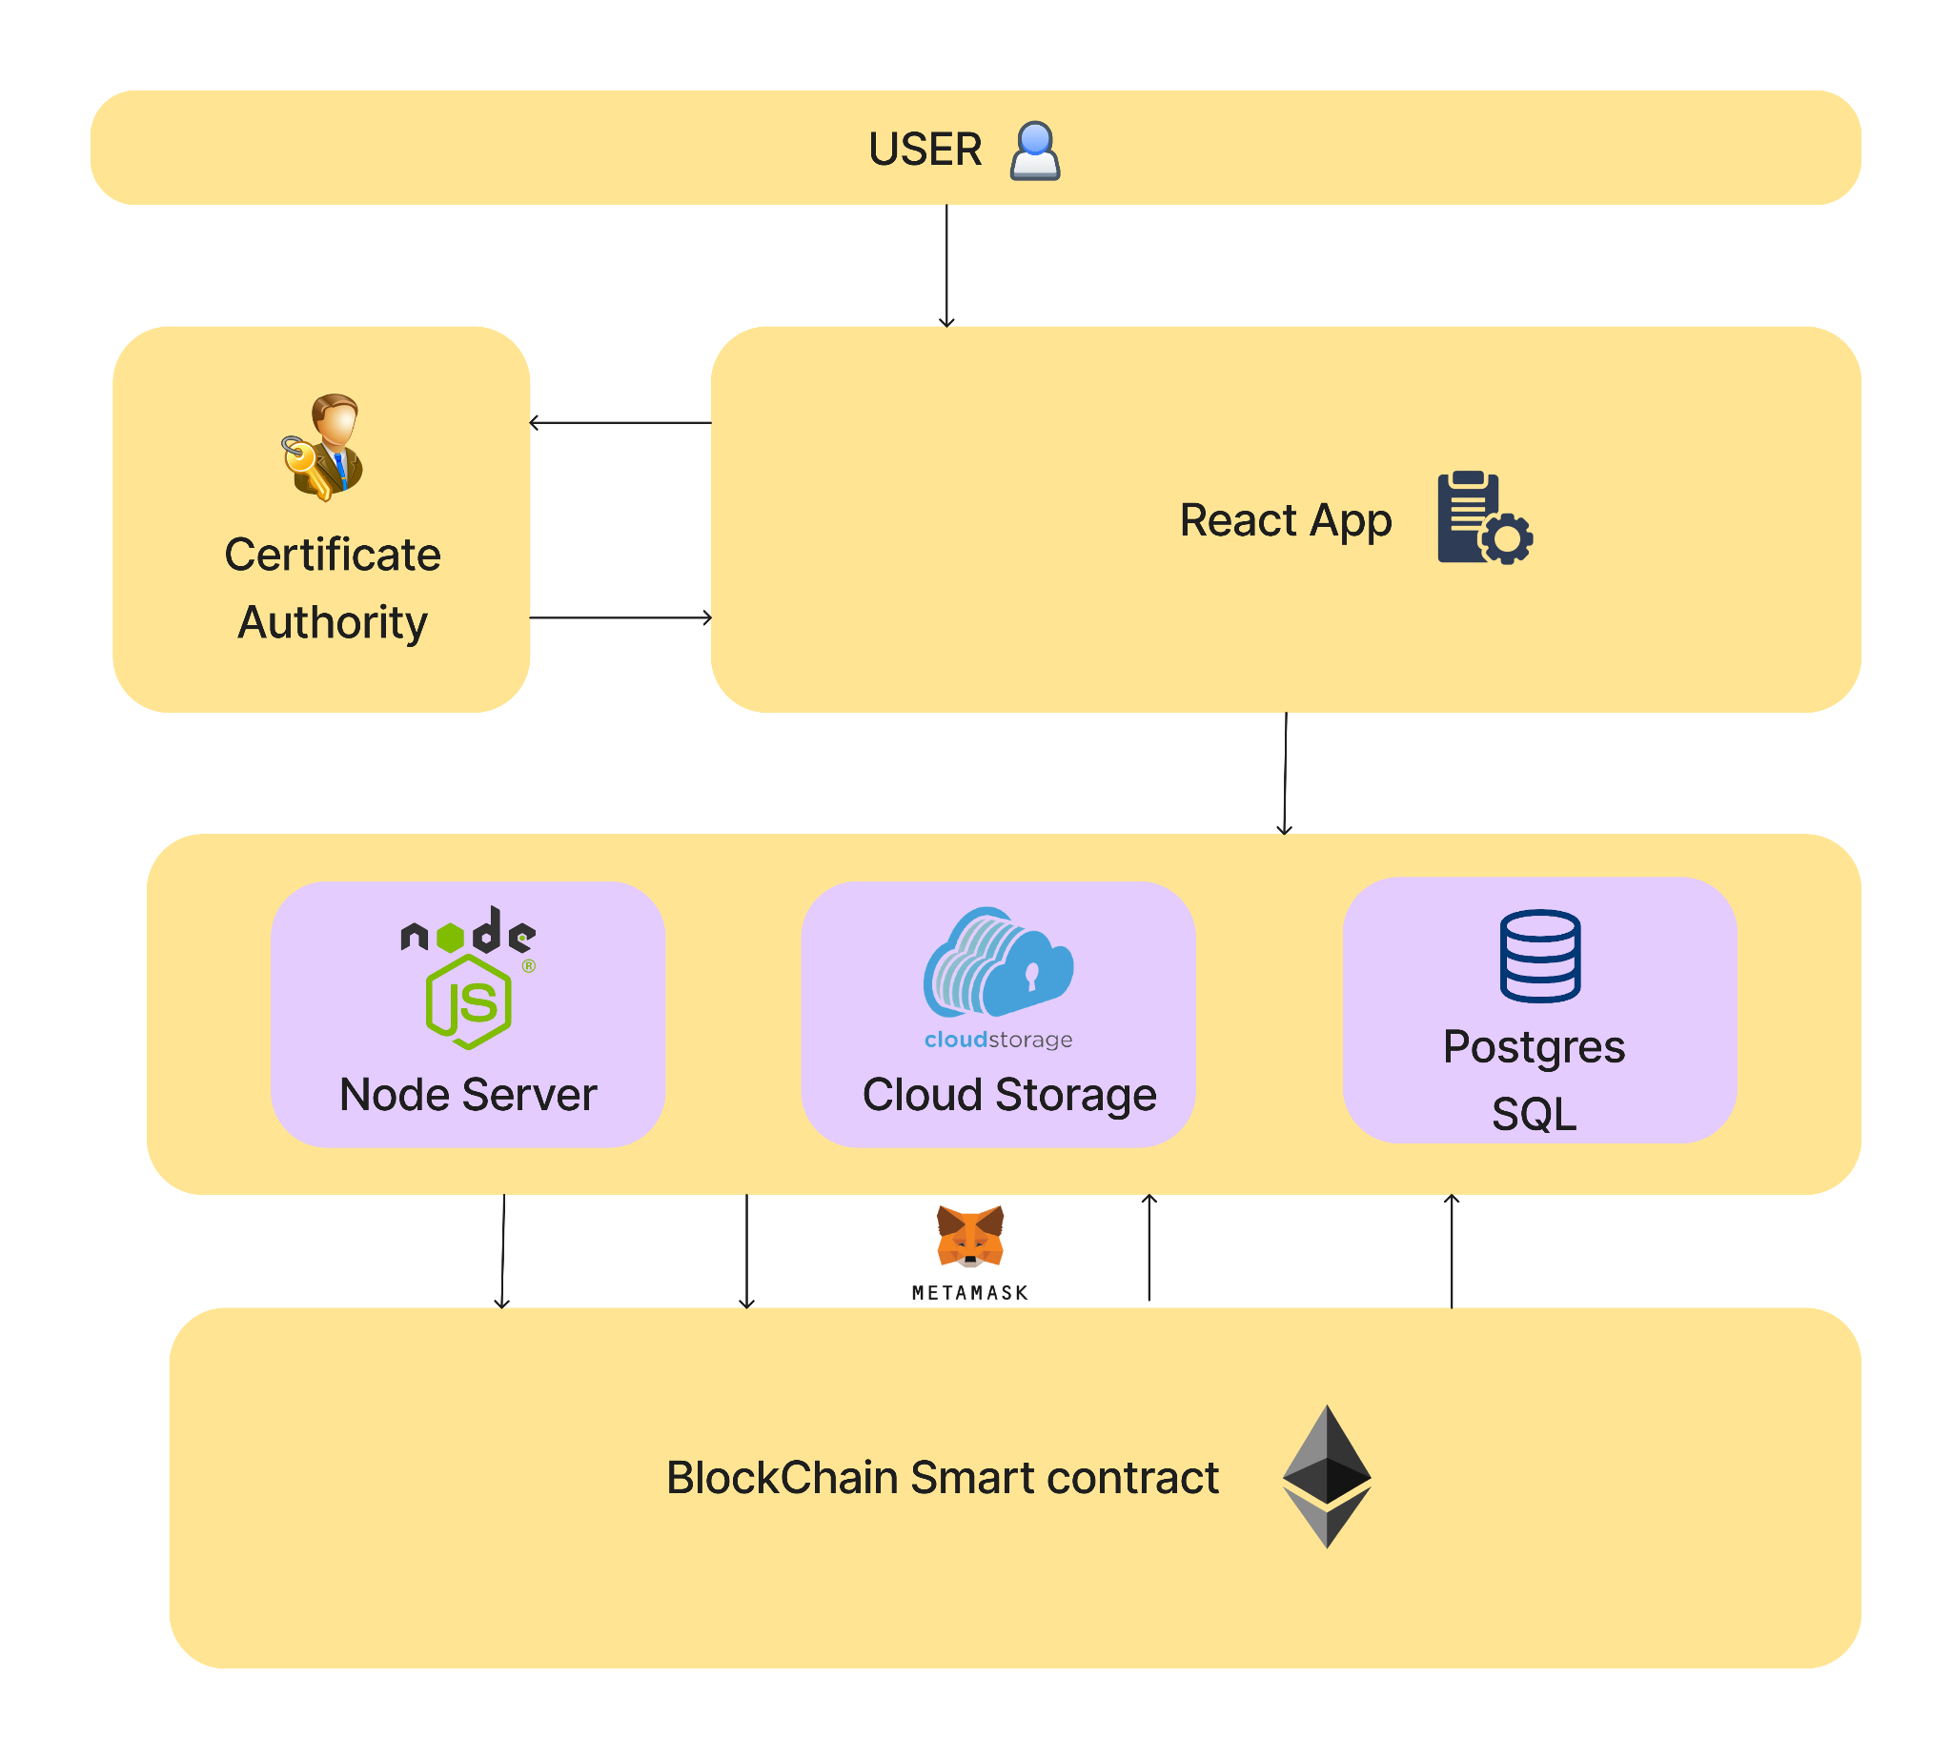
Idea/Approach Details
System Architecture
Idea/Solution/prototype
A secure, immutable application for digital credentials.
Certificates in OwnCloud, dynamic data in a database.
Blockchain-WhatsApp for certifying immutable data
Innovation
Dynamic QR code with blockchain hash for certificates.
Scalable certificate batching using a unique key.
Employing biometrics to securely update blockchain data
Certificate decodes location for origin and session details.
Hash value stored locally for offline verification.
Whatsapp Integration for verification of the certificate
Technology stack
BlockChain
Solidity
Ethereum blockchain
Metamask(wallet)
Hardhat(deployment)
Front End
ReactJS
Back End
node.js
web3.js
express
Open Source Cloud Storage
OwnCloud
Economical Impact
Our solution is associated with the
Goal 8 : Decent Work and Economic Growth
Organizations pay for versions: rent or one-time.
User charges for certificate services.
Establishing update centers creates jobs.
USP
Regional Language Support
Offline updation centres like Aadhar
Integration with OwnCloud to eliminate constraint related to data localization

Slide 3
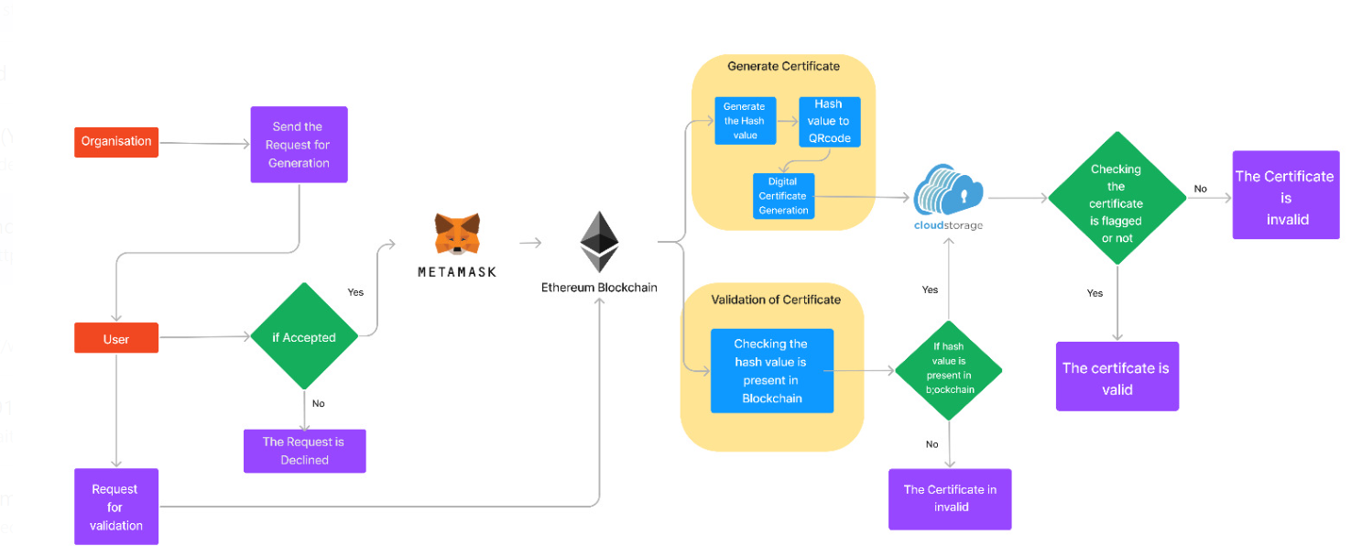
Idea/Approach Details
Process Flow

Slide 4
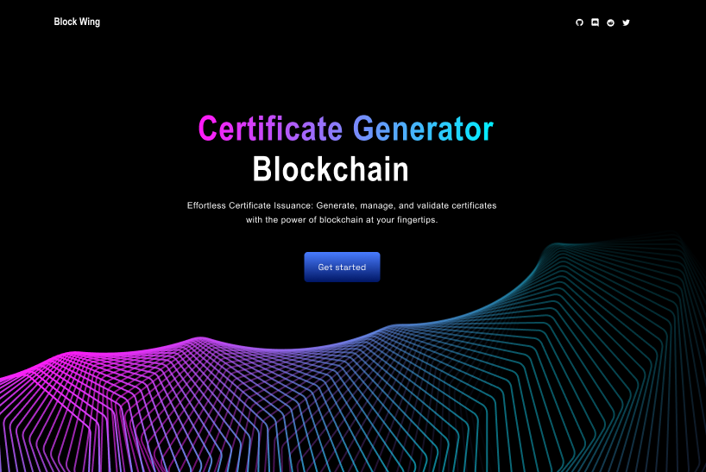
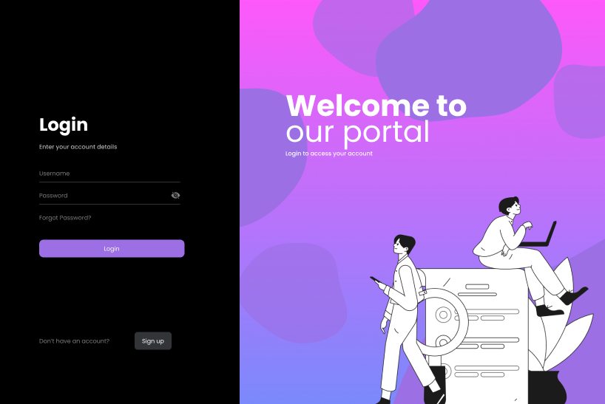
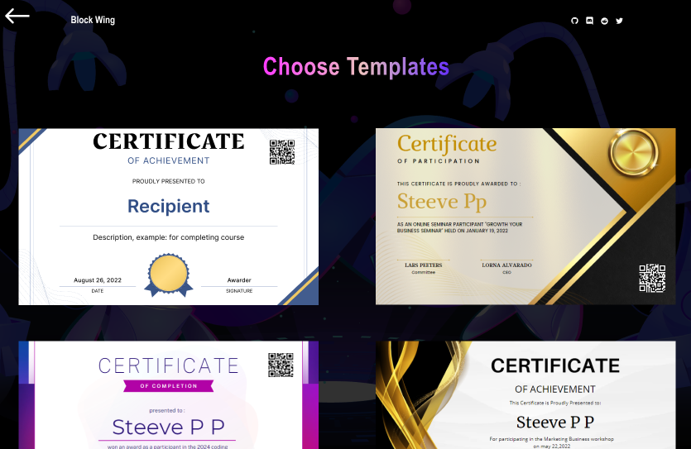
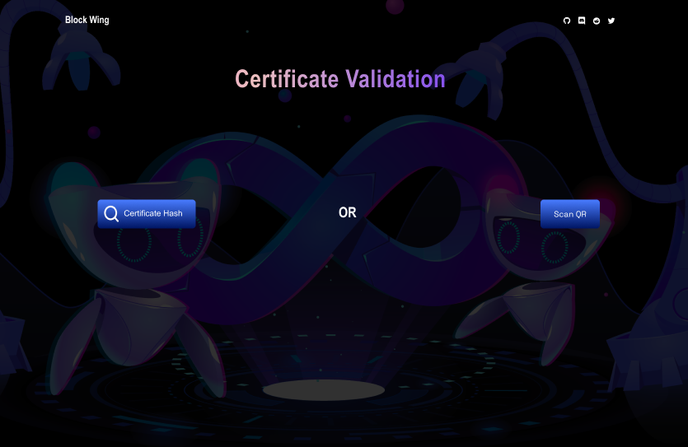
Idea/Approach Details
User Interface
Use Cases
Government can issue certificates on blockchain.
Blockchain improves election security and transparency in voting.
Blockchain enhances healthcare record security.
Validation of Bill of Lading in cross-border transport
Blockchain can be utilized in E-notary services
Dependencies /stopper
Dependence on a stable blockchain infrastructure.
Government cooperation needed for data integration.
Regulatory and privacy hurdles may hinder adoption.
Blockchain setup and maintenance can be expensive.
Figma Link: Click Here
Youtube Link : Click Here

Slide 5
Team Member Details
Team Leader Name: Steeve PP
Branch (Btech/Mtech/PhD etc): Btech Stream (ECE, CSE etc): CSE Year (I,II,III,IV): II
Team Member 1 Name: Meera Srilekha.B
Branch (Btech/Mtech/PhD etc): Btech Stream (ECE, CSE etc): CSE Year (I,II,III,IV): II
Team Member 2 Name: Karen Joseph
Branch (Btech/Mtech/PhD etc): Btech Stream (ECE, CSE etc): CSE Year (I,II,III,IV): III
Team Member 3 Name: Tarigopula Bhavya
Branch (Btech/Mtech/PhD etc): Btech Stream (ECE, CSE etc): CSE Year (I,II,III,IV): III
Team Member 4 Name: Ishan Chaskar
Branch (Btech/Mtech/PhD etc): Btech Stream (ECE, CSE etc): CSE Year (I,II,III,IV): III
Team Member 5 Name: Christin V Eliyas
Branch (Btech/Mtech/PhD etc): Btech Stream (ECE, CSE etc): CSE Year (I,II,III,IV): II
Team Mentor Name: Vinoth Ewards
Category (Academic/Industry): Academic Expertise (AI/ML/Blockchain etc): Domain Experience (in years):

